Slide 1
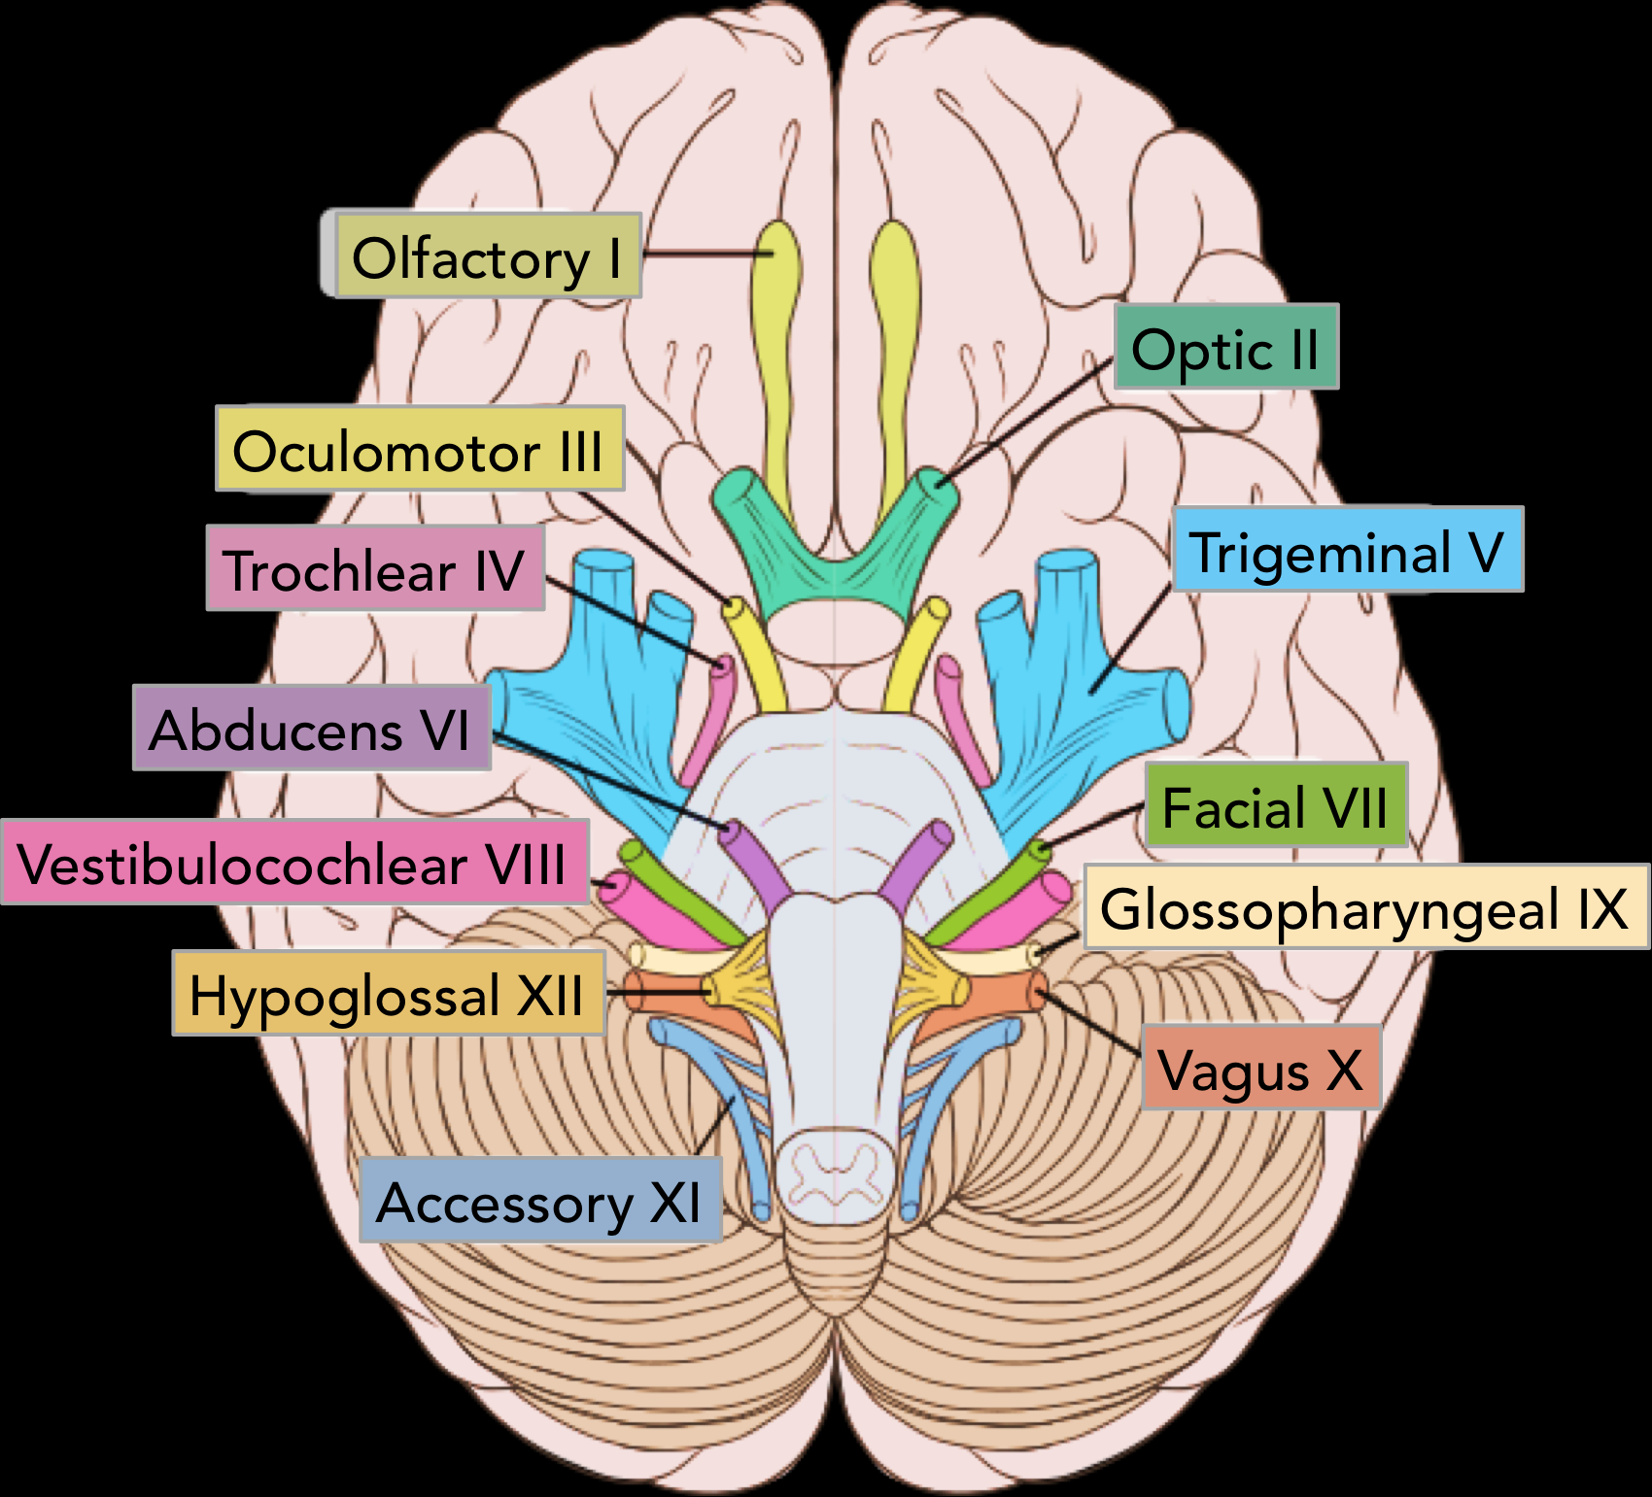
Nervous System: Cranial Nerves
Al-Farabi Kazakh National University
Higher School of Medicine

Slide 2
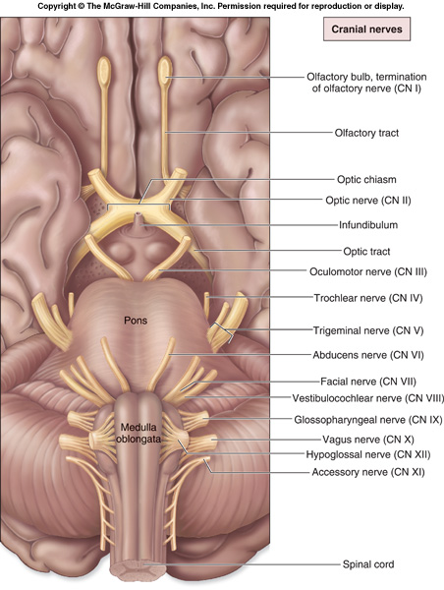
Cranial Nerves
Indicated by Roman numerals I-XII from anterior to posterior
May have one or more of 3 functions
Sensory (special or general)
Somatic motor (skeletal muscles)
Parasympathetic (regulation of glands, smooth muscles, cardiac muscle)
Proprioception
Positional information of body parts

Slide 3
Cranial Nerves
Olfactory (I)
Optic (II)
Oculomotor (III)
Trochlear (IV)
Trigeminal (V)
Abducens (VI)
Facial (VII)
Vestibulocochlear (VIII)
Also known as auditory
Glossopharyngeal (IX)
Vagus (X)
Accessory (XI)
Also known as spinal accessory
Hypoglossal (XII)

Slide 4
Mnemonic Aids for Cranial Nerves
On Old Olympus Towering Tops A Famous Vocal German Viewed Some Hops
Olfactory, Optic, Oculomotor, Trochlear, Trigeminal, Abducens, Facial, Vestibulocochlear, Glossopharyngeal, Vagus, Spinal Accessory (Accessory), Hypoglossal

Slide 5
Mnemonic Aids for Sensory and /or Motor Functions of Cranial Nerves
Some Say Marry Money, But My Brother Says Big Business Matters More
The first letter of each word signifies whether the particular cranial nerve is sensory only (S); motor (M); or both sensory and motor (B)

Slide 7
Corticonuclear tract (motor pathway)
I motor neuron-The lower part of the anterior central gyrus
Corona radiata
Genu of the internal capsule
Cerebral peduncles
II motor neuron (brainstem nucleas)
Muscles

Slide 8
Sensory pathways of cranial nerves
Receptor
I neuron- Ganglion
II neuron brainstem nucleas
III neuron- thalamus
Posterior 1/3 of posterior genu of the internal capsule
Lower part of posterior central gyrus

Slide 9
The main functions of the cranial nerves
Olfactory- smell
Optic- vision
Oculomotor- 4 of the 6 extrinsic eye muscles
Trochlear- extrinsic eye muscles
Trigeminal- sensory fibers to the face and motor fibers to the chewing muscles
Abducens- controls eye muscles that turn the eye laterally
Facial- facial expression
Vestibulocochlear- hearing and balance
Glosopharyngeal- tongue and pharynx
Vagus- from medulla- acetylcholine slows heart & breathing
Accessory- accessory part of vagus nerve
Hypoglossal- moves muscles under tongue

Slide 10
I. Olfactory Nerve
It is a sensory nerve that transmits a sensory information to the brain alowing us to have a sence of smell
Olfactory nerve is only one component of the overall pathway and is, in fact, made up of multiple nerve fibers/rootlets coming from the receptors cells.
Notes:
The afferent axons, pictured here as the yellow hair like extensions that line the roof of the nasal cavity respond to volatile small molecule odorants, non-volatile proteins, and non-volatile hydrocarbons. All of the aforementioned cause olfaction sensations, which we perceive as smell.

Slide 11
I. Olfactory Nerve
The olfactory epithelium occupies the superior part of the nasal cavity (Olfactory mucosa in nasal cavity), covering the inferior surface of the cribriform plate and extending down along the superior nasal conchae.
Each has a single odor sensitive dendrite projecting from one side of the cell body and an unmylinated axons extending from the other side.
Bundle of axons of olfactory receptors extend through about 20 olfactory foramina in the cribriform plate of the ethmoid bone

Slide 12
I. Olfactory Nerve
Olfactory nerves end in the brain in paired masses of gray matter called the olfactory bulbs. Two extensions of the brain that rest on the cribriform plate.
Within the olfactory bulbs, the axon terminals of olfactory receptor form synapses with the dendrite and cell bodies of the next neurons in the olfactory pathway.
The axons of these neuron make up the olfactory tract, which extend posteriorly from the olfactory bulbs.
Axons in the olfactory tract end in the primary olfactory area in the temporal lobe of the temporal cerebral cortex.

Slide 13
The pathway can be summarized as follows:
olfactory receptor cells
olfactory nerves
olfactory bulb
olfactory tract
olfactory striae
olfactory cortex
output targets of the olfactory cortex

Slide 14
Olfactory testing
Determine whether subject can smell (not necessarily identify) aromatic substances such as:
coffee, vanilla,
clove oil, or soap

Slide 15
Nota bene! ( Pay special attention)
Harsh odorous substances (alcohol, acetic acid, etc.) cannot be used, because they irritate not only 1 pair, but also the trigeminal and glossopharyngeal nerves

Slide 16
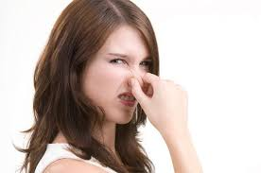
Effect of Damage
Impaired sense of smell

Slide 17
II Optic Nerve
Sensory nerve
Contains axons that conduct nerve impulses for vision.
In the retina, rods and cones initiate visual signals and relay them to bipolar cells, which transmit the signals to ganglion cells.
Axons of all ganglion cells in the retina of each eye join to form an optic nerve, which pass through the optic foramen.

Slide 18
II Optic Nerve
Posterior to the eyeball, the two optic nerves merge to form the optic chiasm.
Within the chiasm, axons from the medial half of each eye cross to the opposite side, axons from the lateral half is remain on the same side.
Posterior to the chiasm, the regrouped axons, some from each eye, form the optic tracts.
Most axons in the optic tracts end in the lateral geniculate nucleus of the thalamus.

Slide 19
II Optic Nerve
There, they synapse with neuron whose axons extend to the primary visual area in the occipital lobe of the cerebral cortex.
A few axons pass through the optic chiasm and then extend to the superior colliculi of the midbrain.

Slide 20
It can be subdivided into four main parts:
•The optic nerve head (i.e. intraocular part) measures about 1 mm in length.
•The intraorbital part is approximately 25 mm in length.
•The intracanalicular part is most variable, ranging between 4 – 10 mm in length.
•The Intracranial part accounts for about 10 mm of the total length of the nerve.

Slide 21
Clinical Test
Inspect retina with
ophthalmoscope;
Test peripheral vision and
Visual acuity

Slide 22
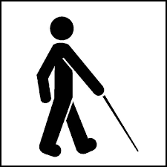
Effect of Damage
Blindness in part or all of visual field

Slide 23
III Oculomotor Nerve
This nerve controls muscles that turn the eyeball up, down, and medially, as well as controlling the iris, lens, and upper eyelid
Motor nerve
Originate in Midbrain
Oculomotor nerve extends anteriorly and divides into superior and inferior branches, both of which pass through the superior orbital fissure into the orbit.
Axons in the superior branch innervate the superior rectus (extrinsic eyeball muscle) and the levator palpebrae superioris (muscles of upper eyelid)

Slide 24
III Oculomotor Nerve
Axons in the inferior branch supply the medial rectus, inferior rectus and inferior oblique muscles (all extrinsic eyeball muscles).
Theses somatic motor neurons control movements of the eyeball and upper eyelid.
The inferior branch of the oculomtor nerve also provides parasympathetic innervation to intrinsic eyeball muscles, which are smooth muscles.

Slide 25
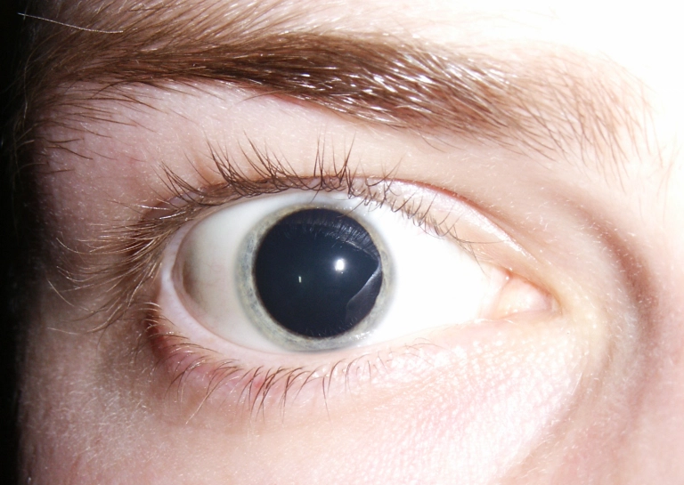
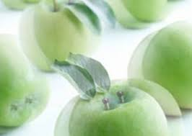
Effect of Damage
Drooping eyelid;
dilated pupil;
inability to move eye in some directions;
tendency of eye to rotate laterally at rest;
double vision;
difficulty focusing

Slide 26
Clinical Test
Look for differences in size and shape of right and left pupils;
test pupillary
response to light;
test ability to track moving objects

Slide 27
IV. Trochlear Nerve
This nerve controls a muscle that directs the vision slightly downward and rotates the top of the eyeball toward the nose, especially in compensating for head movements.
This is the only cranial nerve that arises from the posterior side of the brainstem.
Motor nerve
Smallest cranial nerve

Slide 28
IV. Trochlear Nerve
The motor neurons originate in the trochlear nucleus in the midbrain, and axons from the nucleus pass through the superior orbital fissure of orbit.
These somatic motor axons innervate the superior oblique muscles of the eyeball. (extrinsic eyeball muscle that control movement of the eyeball)

Slide 29
Effect of Damage
Double vision and weakened ability to look downward;
eye points superolaterally and subject tends to tuck the chin in and tilt the head downward to minimize the double vision

Slide 30
Clinical Test
Ask subject to tilt the head toward one shoulder; affected eye shows upward deviation when head is tilted toward that side (Bielschowsky’s head tilt test)

Slide 31
V. Trigeminal Nerve
Mixed nerve
Largest cranial nerve
2 roots from venterolateral of the pons
Have large sensory root and small motor root

Slide 32
V. Trigeminal Nerve
The main function of the trigeminal nerve is to receive sensation from the face and control the four muscles of mastication (the masseter, temporalis,medial pterygoid, and the lateral pterygoid.)

Slide 34
VI. Abducens Nerve
This nerve controls a muscle that turns the eyeball laterally.
Motor nerve
Origin – abducens nucleus of the pons
Somatic motor axons extend from the nucleus to the lateral rectus muscle of the eyeball, through the superior orbital fissure of the orbit

Slide 35
Effect of Damage
Inability to turn eye laterally; at rest, eye turns medially because of action of antagonistic muscles
Clinical Test
Test lateral eye movement

Slide 36
VII. Facial Nerve
This is the major motor nerve of the facial muscles.
Origin:
Sensory: Taste buds of anterior two-thirdsof tongue
Motor: Pons
Termination:
Sensory: Thalamus
Motor: Somatic fibers to digastric muscle, stapedius muscle of middle ear, stylohyoid muscle, muscles of facial expression.
Autonomic fibers to submandibular and sublingual salivary glands, tear glands, nasal and palatine glands
Cranial Passage: Internal acoustic meatus and
stylomastoid foramen

Slide 37
Five prominent branches:
Temporal
Zygomatic
Buccal
Mandibular
Cervical

Slide 38
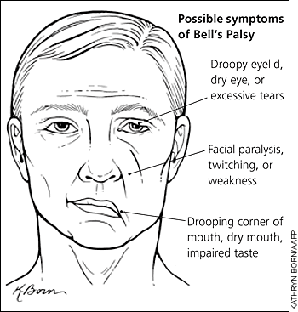
Effect of Damage
Inability to control facial muscles;
sagging due to loss of muscle tone;
distorted sense of taste,especially for sweets

Slide 39
VIII. Vestibulocochlear Nerve
This is the nerve of hearing and equilibrium, but it also has motor fibers that lead to cells of the cochlea that tune the sense of hearing.
Origin:
Sensory: Cochlea,
vestibule, and
semicircular ducts
of inner ear
Motor: Pons
Cranial Passage: Internal acoustic meatus

Slide 40
VIII. Vestibulocochlear Nerve
Termination:
Sensory: Fibers for hearing end in medulla; fibers for equilibrium end at junction of medulla and pons
Motor: Outer hair cells of cochlea of inner ear

Slide 41
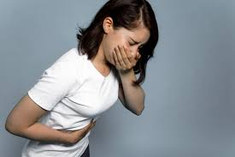
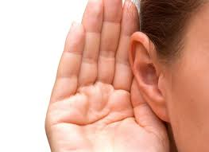
Effect of Damage
Nerve deafness, dizziness, nausea, loss of balance, and nystagmus (involuntary rhythmic oscillation of eyes from side to side)

Slide 42
IX. Glossopharyngeal Nerve
This is a complex, mixed nerve with numerous sensory and motor functions in the head, neck, and thoracic regions
Sensation from the tongue, throat, and outer ear; control of food ingestion; and some aspects of cardiovascular and respiratory function.
Cranial Passage: Jugular foramen

Slide 43
IX. Glossopharyngeal Nerve
Origin:
Sensory: Pharynx; middle and outer ear; posterior onethird of tongue (including taste buds); internal carotid artery
Motor: Medulla oblongata
Termination
Sensory: Medulla oblongata
Motor: Parotid salivary gland; glands of posterior tongue; stylopharyngeal muscle (which dilates pharynx during swallowing)

Slide 44
Effect of Damage
Loss of bitter and sour taste;
Impaired swallowing

Slide 45
X. Vagus Nerve
The vagus has the most extensive distribution of any cranial nerve, supplying not only organs in the head and neck but also most viscera of the thoracic and abdominopelvic cavities. It plays major roles in the control of cardiac, pulmonary, digestive, and urinary functions.

Slide 46
Function
Sensory:
Taste; sensations of hunger, fullness, and gastrointestinal discomfort
Motor:
Swallowing, speech, deceleration of heart, bronchoconstriction, gastrointestinal secretion and motility

Slide 47
Sensory axon
Аrise from:
Thoracic and abdominopelvic viscera
root of tongue
pharynx, larynx
epiglottis
outer ear
dura mater
These axons pass through the jugular foramen
and end in the : Medulla
oblongata and pons

Slide 48
Motor axons
Arise from: Medulla oblongata
Terminate:
Tongue,
palate,
pharynx, larynx,
lungs, heart, liver
spleen, digestive tract,
kidney, ureter

Slide 49
Effect of Damage
Hoarseness or loss of voice;
Impaired swallowing and gastrointestinal
motility;
Fatal if both vagus nerves are damaged

Slide 50
XI. Accessory Nerve
Motor nerve
Motor axons arise in the anterior gray of the 1st 5 segments of the cervical portion of the spinal cord.
The axons from the segment exit the spinal cord laterally and come together, pass through the foramen magnum and exit through the jugular foramen along with the vagus nerve.

Slide 51
XI. Accessory Nerve
The accessory nerve controls mainly swallowing and neck and shoulder muscles
(Termination: Palate, pharynx, trapezius and sternocleidomastoid muscles)

Slide 52
Effect of Damage
Impaired movement of head, neck, and houlders;
Difficulty shrugging shoulder on damaged side;
Paralysis of sternocleidomastoid, causing head to turn toward injured side

Slide 53
XII. Hypoglossal Nerve
Motor nerve
Somatic motor axons originate in the hypoglossal nuclei in the MO, pass through the hypoglossal canal, and supply the muscles of the tongue.

Slide 54
XII. Hypoglossal Nerve
These axons conduct impulses for speech and swallowing.

Slide 55
Effect of Damage
Impaired speech and swallowing;
inability to protrude tongue if both right and left nerves are damaged;
deviation of tongue toward injured side,
and atrophy on that side, if only one nerve is damaged

Slide 56
Points to Remember
Cranial nerves are part of the peripheral nervous system.
Carry sensory or motor information or a combination and function in parasympathetic nervous system.
Cranial nerves I, II and VIII are purely sensory.
Cranial nerves III, IV, VI, XI and XII are motor (although also function for proprioception).

Slide 57
Short Quiz

Slide 58
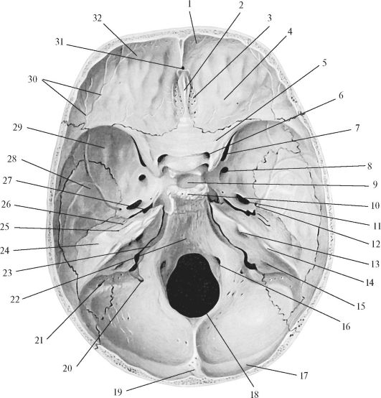
Let's recall the main outputs of the cranial nerves

Slide 59
